Slide 1

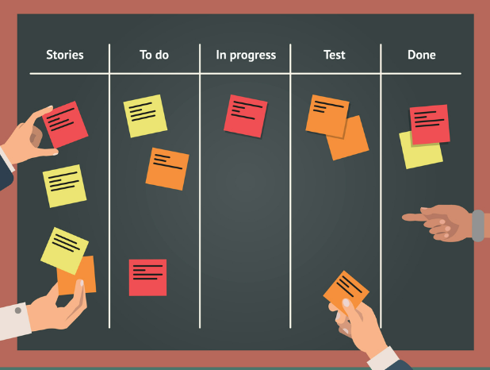
Kanban Software (Microsoft Planner)
EPM 2113 Fall 2023

Slide 2
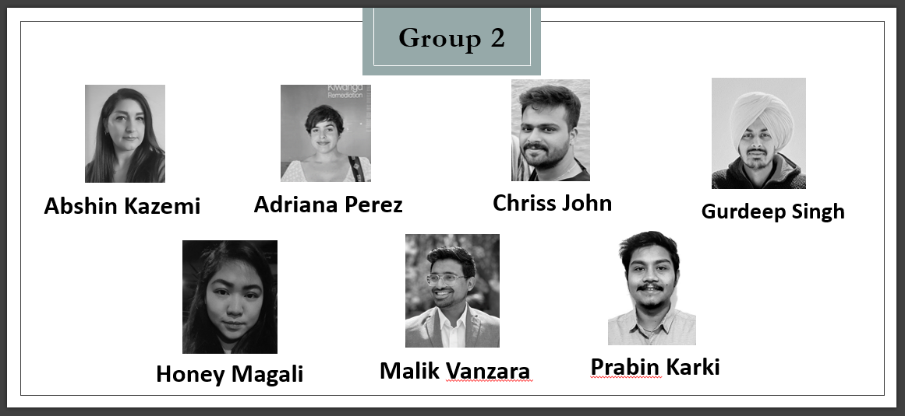
2

Slide 3

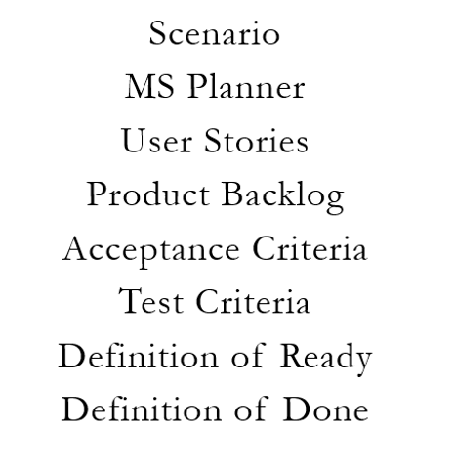
Agenda

Slide 4

Scenario
Understanding SAOS's Current Workflow
Addressing Operational Challenges
Towards a Solution: Computerized Ordering System
Chriss

Slide 5

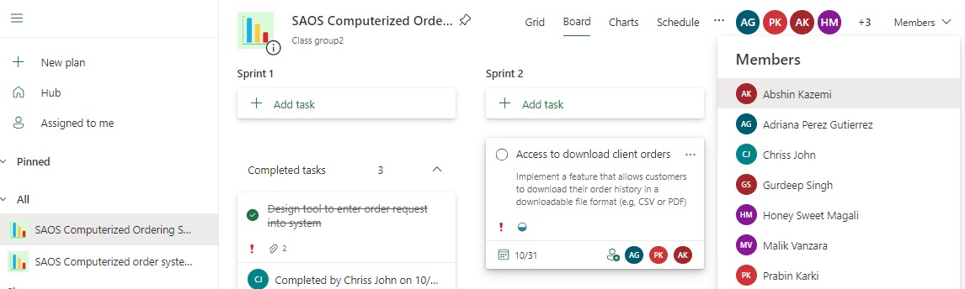
Microsoft Planner
Help teams organize, collaborate, and manage their projects more efficiently.
Task Management
Visual Boards
Collaboration
Deadline Tracking
Notifications
Microsoft Integration
Accessibility
Reporting
Chriss

Slide 6
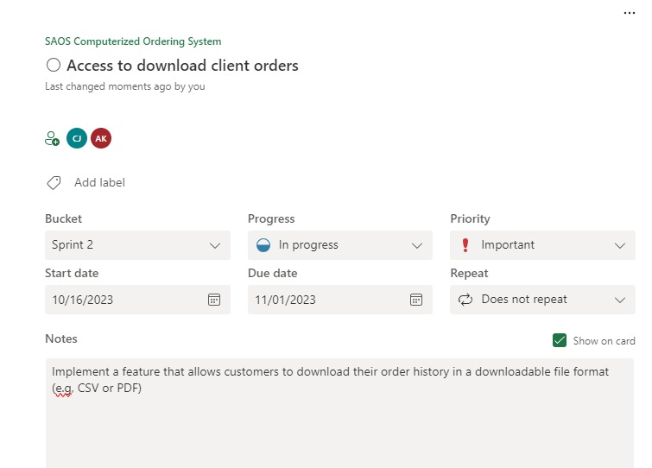
User Stories
User Story: As a customer, I want to be able to download my order history as a file
(view save for reference)
Description: Implement a feature that allows customers to download their order history in a downloadable file format (e.g., CSV or PDF).
Adriana

Slide 7
Product Backlog
User Story 1: As a customer, I want to enable two-factor authentication for extra security.
Description: feature allowing customers to enable two-factor authentication
User story 2: As a client administrator, I want to enforce two-factor authentication for all users. Description: functionality that enables client administrators to mandate 2FA for all users
User story 3: As a system administrator, I want to configure and manage two-factor authentication settings
Description: administrative panel allowing system administrators to configure and manage the settings related to 2FA.
Adriana

Slide 8
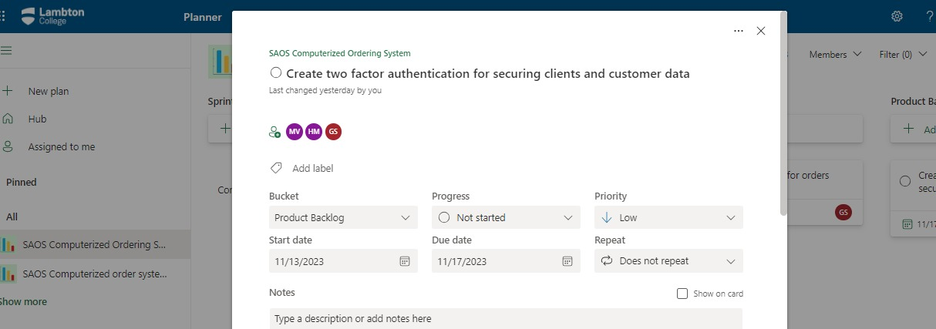
Adriana

Slide 9

Acceptance Criteria
Acceptance Criteria (within the User Story):
Creating order requests in the system via a design tool.
User Interface Design:
Tool's interface is user-friendly, intuitive, and adaptable.
Guarantees smooth operation on desktop and other platforms.
Order Request Submission:
Completion of the order request form:
Validate the information for accuracy and completeness.
Successful submission:
Confirmation message to signify receipt and processing of the order request.
Malik

Slide 10
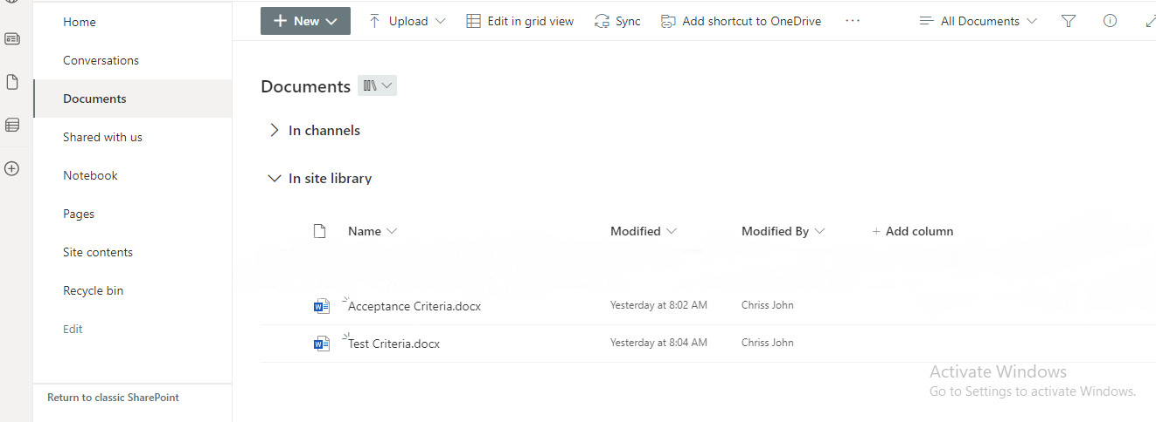
Acceptance Criteria
Malik

Slide 11

Test Criteria
Test Criteria (within the User Story):
A design tool to create order requests into the system
Test user interface across different devices for compatibility.
Conduct usability testing to assess user-friendliness.
Ensure compatibility with various screen sizes.
Evaluate the responsiveness of the tool on different devices.
Test order request form with valid and invalid input data.
Verify accurate processing of information.
Ensure appropriate handling of errors.
Display relevant error messages when necessary.
Honey

Slide 12
Adding Document Checklist in MS Planner
Honey

Slide 13
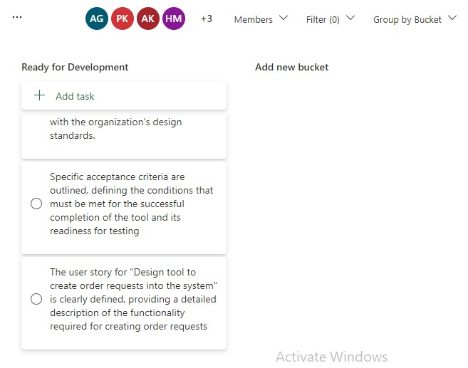
Definition of Ready
Specifies the criteria a user story must meet before it can be pulled into the "In Progress" phase.
Design tool to create order requests
Specific acceptance criteria are outlined
Design and wireframes for the tool’s interface
System requirements and dependencies
User stories reviewed and approved
Development team has access to essential resources
Gurdeep

Slide 14
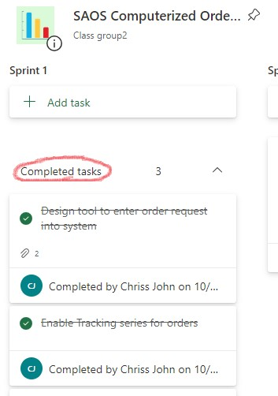
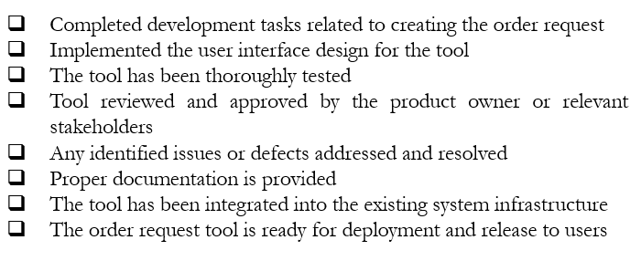
Definition of done
Criteria a user story must satisfy to be considered completed and ready for release
Prabin

Slide 15
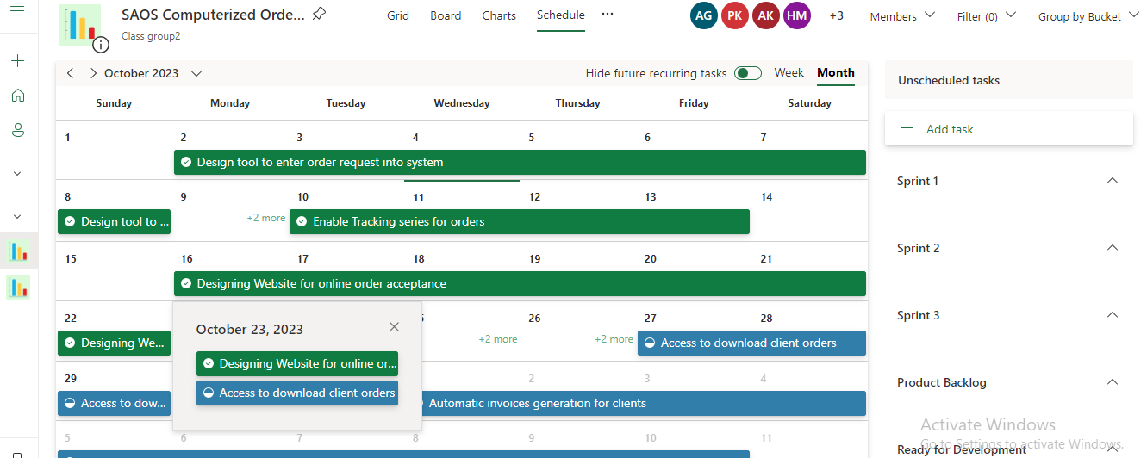
Schedule
Abshin

Slide 16
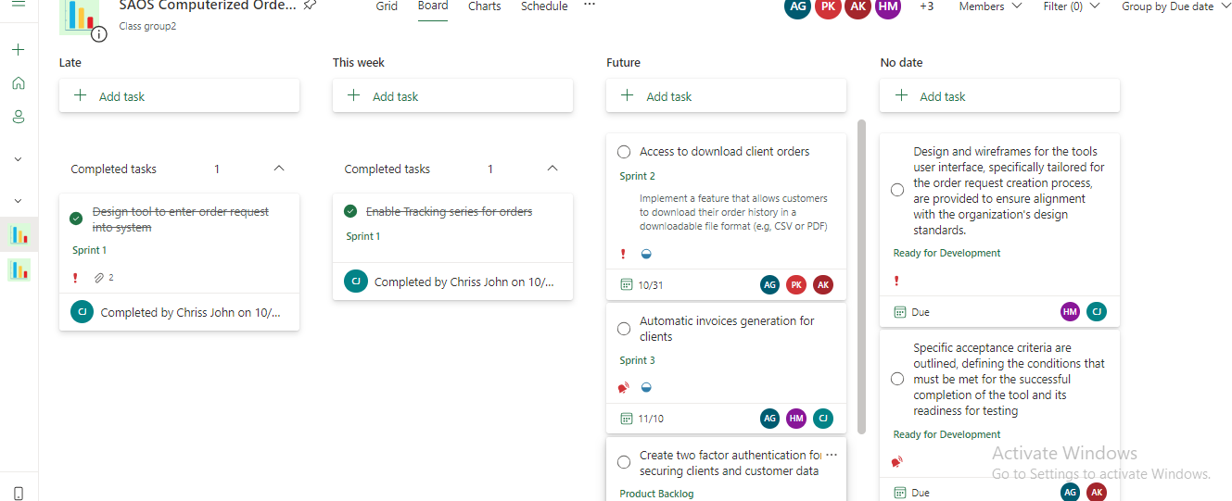
Board (Grouped by Due date)
Abshin

Slide 17
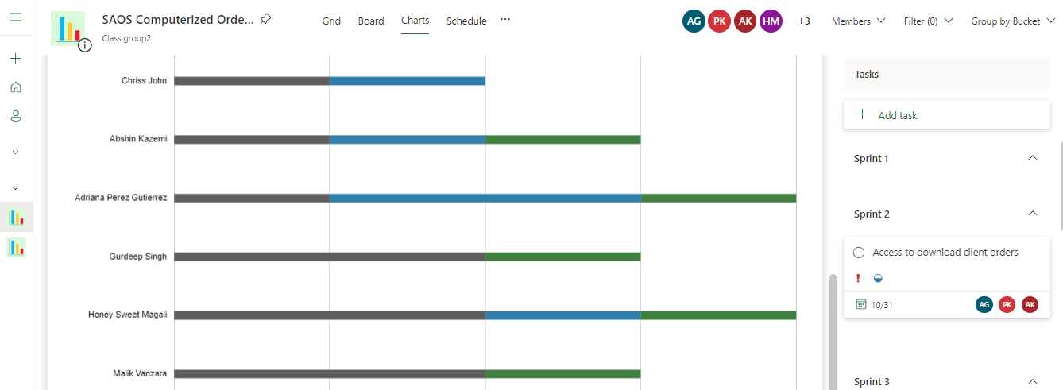
Visual Concept
Abshin

Slide 18
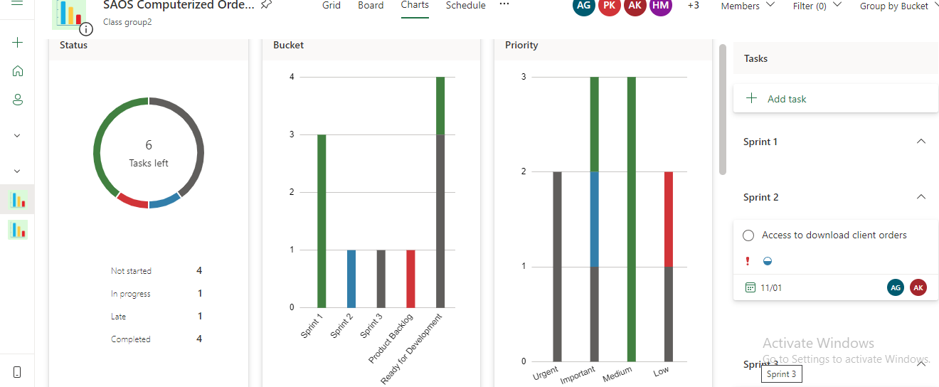
Task Result
Abshin

Slide 19
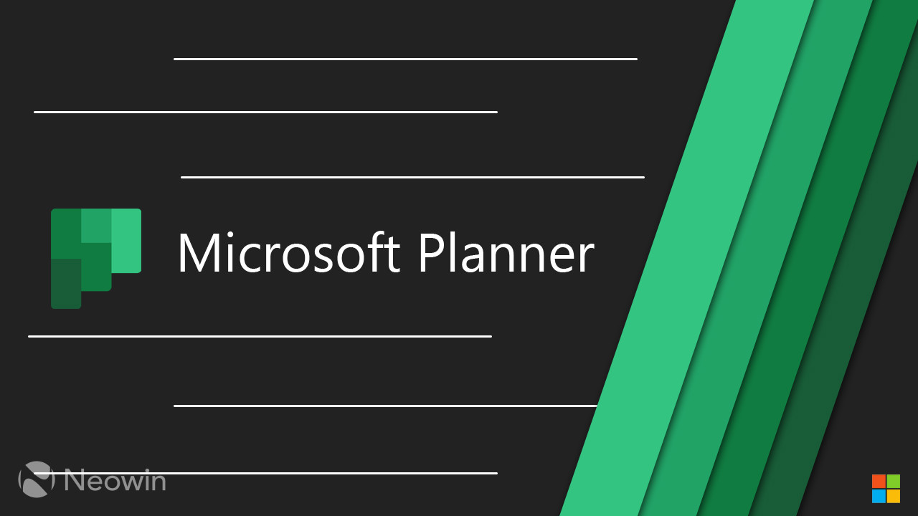
Thank you

